Slide 1
Smart home Secured by face recognition
Name : Amr Heikal ID: 75452
Name: Mahmoud Hamdo ID: 64676
Name: Amr Essam ID: 46543
Name: Ahmed Madeh ID:40033
Name: mohamd omar ID: 58686

Slide 2
smart home face recognition :
IDEA OF THIS PROJECT :
IN THIS HOME AUTOMATION PROJECT , WE WILL DESIGN IN
ARDUINO CONTROL RELAY MODULE TO CONTROL 4 HOME
APPLICATIONS.
THIS SMART RELAY MODULE CAN BE CONTROLLED FROM A MOBILE
BLUETOOTH OR SMARTPHONE BY AN ANDROID APP.
IN THIS PROJECT WE DETECT FIRES AND TEMPERATURE

Slide 3
THIS SMART HOME HAS THE FOLLOWING FEATURES :
HOME APPLICATION CONTROLLED BY MOBLIE BLUETOOTH
DISPLAY THE LIVE TEMPERATURE
INBUILT ARDUINO CODE CAN BE APLOADED TO THE RELAY MODULE
DETECTING FIRES

Slide 4
COMPONENTS DETAILS :
ARDUINO NANO
BLUETOOTH MODULE
4- CHANNEL 5V RELAY MODULE
TEMPERATURE SENSOR (LM35)
FLAME SENSOR
BUZZER
LCD

Slide 5
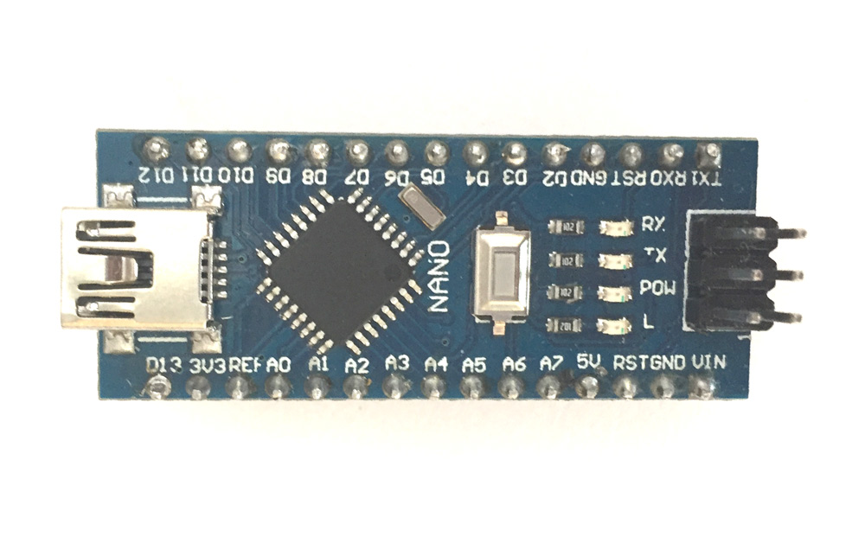
ARDUINO NANO :

Slide 6
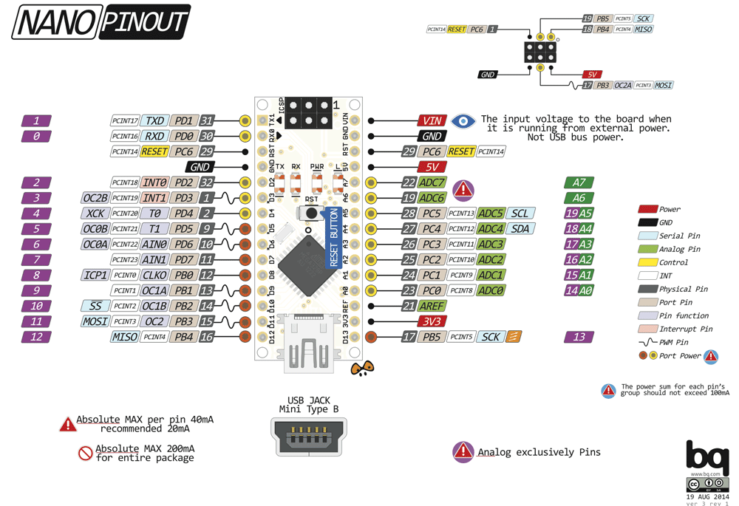
ARDUINO NANO :

Slide 7
1
Microcontroller | ATmega328P – 8 bit AVR family microcontroller
Operating Voltage | 5V
Recommended Input Voltage for Vin pin | 7-12V
Analog Input Pins | 6 (A0 – A5)
Digital I/O Pins | 14 (Out of which 6 provide PWM output)
DC Current on I/O Pins | 40 mA
DC Current on 3.3V Pin | 50 mA
Flash Memory | 32 KB (2 KB is used for Bootloader)
SRAM | 2 KB
EEPROM | 1 KB
Frequency (Clock Speed) | 16 MHz
Communication | IIC, SPI, USART

Slide 8
Arduino Nano
The Arduino Nano is a small, complete, and breadboard-friendly board based on the ATmega328.
We will use it in our project (Smart Home)
Low Cost
High Efficiency
Suitable time
Practical size

Slide 9
HOW TO USED ARDUINO NANO :
It will hardly take 5-10 minutes to upload you first program to Arduino Nano. All you need the Arduino IDE an USB cable and your Nano board itself.
Download and Install Arduino:
The first step would be install the Arduino IDE which is available for download for free from the below link. After installing Arduino you might also want to install the drivers (link given below) for you Arduino to communicate with your Computer
Arduino IDE Download
Driver Download
It will hardly take 5-10 minutes to upload you first program to Arduino Nano. All you need the Arduino IDE an USB cable and your Nano board itself.
Download and Install Arduino:
The first step would be install the Arduino IDE which is available for download for free from the below link. After installing Arduino you might also want to install the drivers (link given below) for you Arduino to communicate with your Computer
Arduino IDE Download
Driver Download

Slide 10
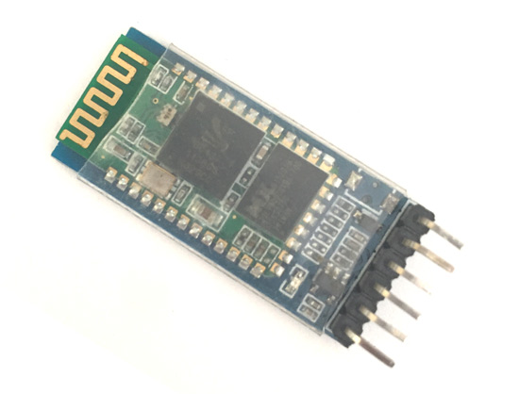
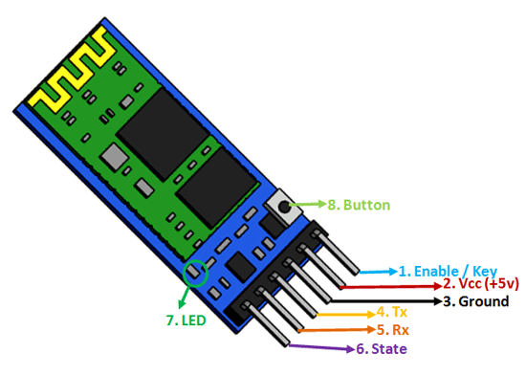
Bluetooth module Hc-05

Slide 11
Pin Configuration :
DESCRIPTION | PIN NAME | PIN NUMBER
This pin is used to toggle between Data Mode (set low) and AT command mode (set high). By default it is in Data mode | ENABLE KEY | 1
Powers the module. Connect to +5V Supply voltage | Vcc | 2
Ground pin of module, connect to system ground. | Ground | 3
Transmits Serial Data. Everything received via Bluetooth will be given out by this pin as serial data. | TX TRANSMITTER | 4
Receive Serial Data. Every serial data given to this pin will be broadcasted via Bluetooth | RX RECEIVER | 5
The state pin is connected to on board LED, it can be used as a feedback to check if Bluetooth is working properly. | STATE | 6
Indicates the status of Module Blink once in 2 sec: Module has entered Command Mode Repeated Blinking: Waiting for connection in Data Mode Blink twice in 1 sec: Connection successful in Data Mode | LED | 7

Slide 12
Bluetooth module Hc-05
We will use it to communicate with mobile app to send notifications to user and receive command

Slide 13
HOW TO USE BLUETOOTH MODULE :
The HC-05 has two operating modes, one is the Data mode in which it can send and receive data from other Bluetooth devices and the other is the AT Command mode where the default device settings can be changed. We can operate the device in either of these two modes by using the key pin as explained in the pin description.
It is very easy to pair the HC-05 module with microcontrollers because it operates using the Serial Port Protocol (SPP). Simply power the module with +5V and connect the Rx pin of the module to the Tx of MCU and Tx pin of module to Rx of MCU as shown in the figure below

Slide 14
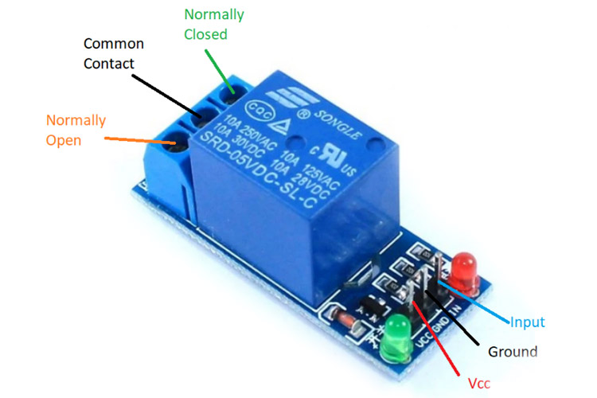
Relay module

Slide 15
Relay module:
Relay is an electromechanical device that uses an electric current to open or close the contacts of a switch. The single-channel relay module is much more than just a plain relay, it comprises of components that make switching and connection easier and act as indicators to show if the module is powered and if the relay is active or not.

Slide 16
Single-Channel Relay Module Pin Description
DESCRIPTION | Pin name | Pin number
Input to activate the relay | RELAY TRIGEGER | 1
0v referance | GROUND | 2
Supply input for powering the relay coil | Vcc | 3
Normally open terminal of the relay | Normally open | 4
Commen terminal of the relay | Common | 5
Normally closed contact the relay | Normally closed | 6

Slide 17
Single-Channel Relay Module Specifications:
Supply voltage – 3.75V to 6V
Quiescent current: 2mA
Current when the relay is active: ~70mA
Relay maximum contact voltage – 250VAC or 30VDC
Relay maximum current – 10A

Slide 18
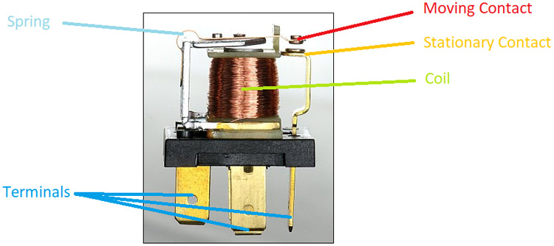
How Does A Relay Work?
The relay uses an electric current to open or close the contacts of a switch. This is usually done using the help of a coil that attracts the contacts of a switch and pulls them together when activated, and a spring pushes them apart when the coil is not energized.

Slide 19
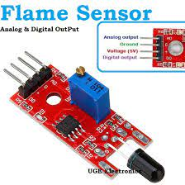
Flame senor
We will use it to check if there is fire or not

Slide 20
WHAT IS A Flame sensor ?
A flame-sensor is one kind of detector which is mainly designed for detecting as well as responding to the occurrence of a fire or flame. The flame detection response can depend on its fitting. It includes an alarm system, a natural gas line, propane & a fire suppression system.

Slide 21
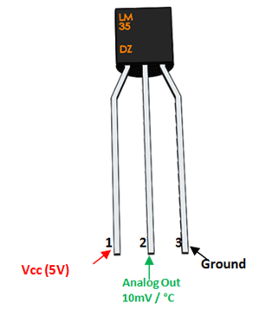
Temperature sensor Lm-35
We will use it to measure temperature to increase quality to determine if there is fire or not.

Slide 22
LM35 Regulator Features:
Minimum and Maximum Input Voltage is 35V and -2V respectively. Typically 5V.
Can measure temperature ranging from -55°C to 150°C
Output voltage is directly proportional (Linear) to temperature (i.e.) there will be a rise of 10mV (0.01V) for every 1°C rise in temperature.
±0.5°C Accuracy
Drain current is less than 60uA
Low cost temperature sensor
Small and hence suitable for remote applications

Slide 23
How to use LM35 Temperature Sensor:
LM35 is a precession Integrated circuit Temperature sensor, whose output voltage varies, based on the temperature around it. It is a small and cheap IC which can be used to measure temperature anywhere between -55°C to 150°C. It can easily be interfaced with any Microcontroller that has ADC function or any development platform like Arduino.
If the temperature is 0°C, then the output voltage will also be 0V. There will be rise of 0.01V (10mV) for every degree Celsius rise in temperature. The voltage can converted into temperature using the below formulae.

Slide 24
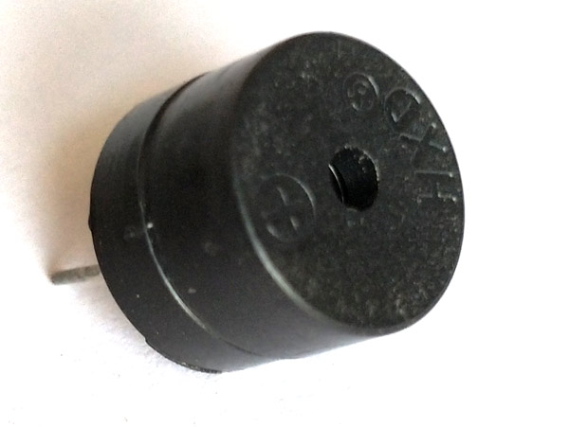
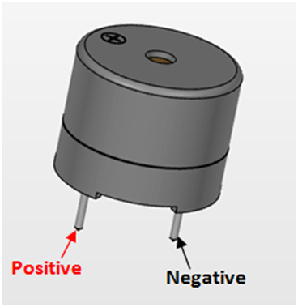
Buzzer
We will use it to give alarm to user that there is fire in home.

Slide 25
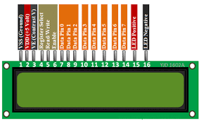
LCD
We will use it to view temperature with Celsius and Fahrenheit

Slide 26
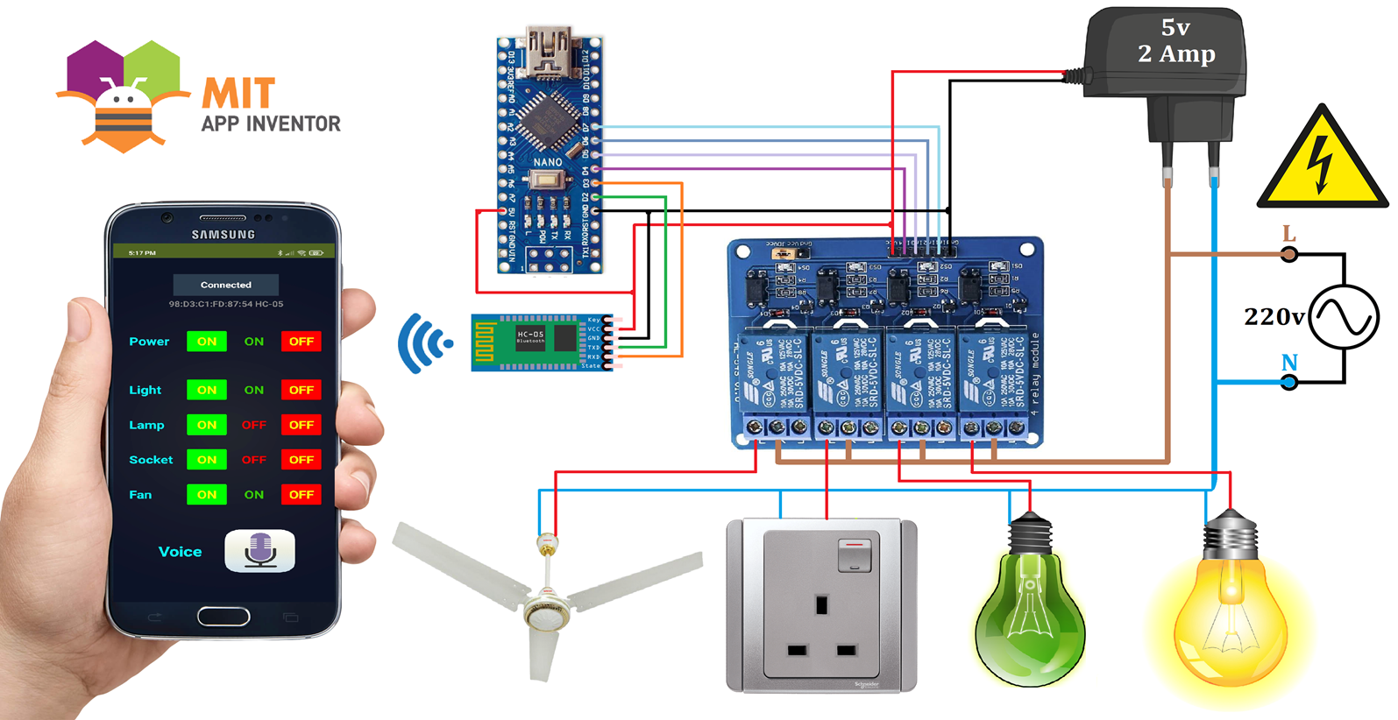

Slide 27
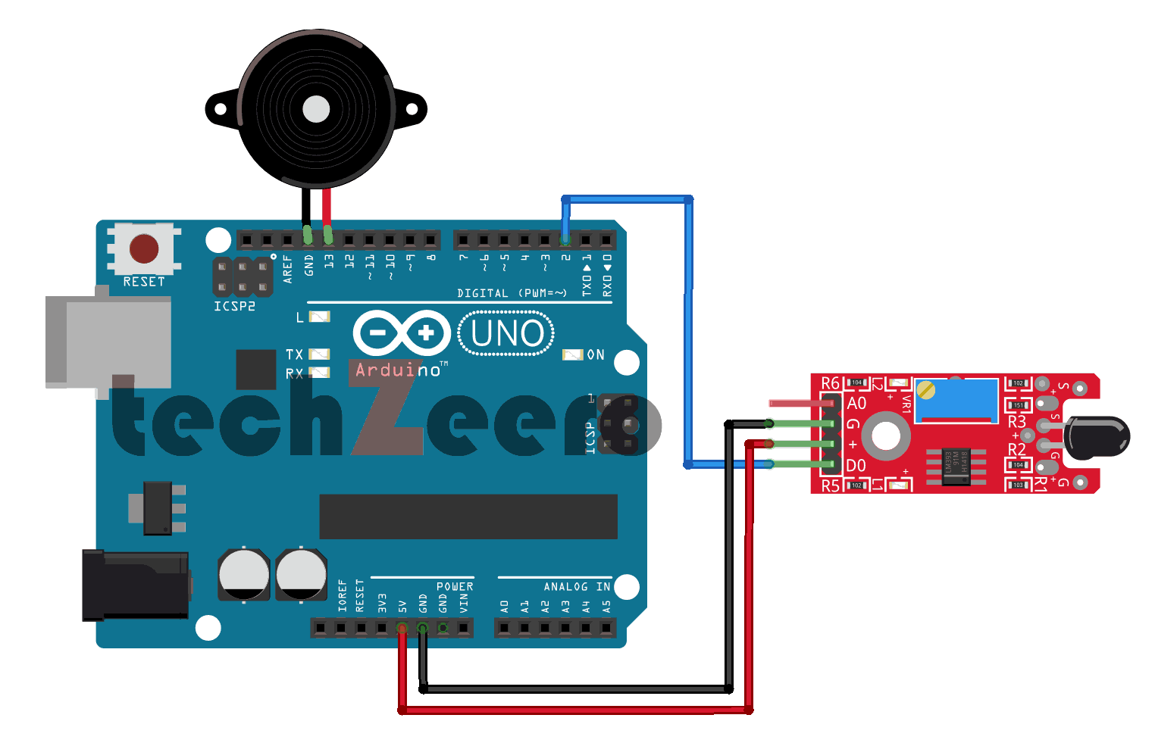

Slide 28
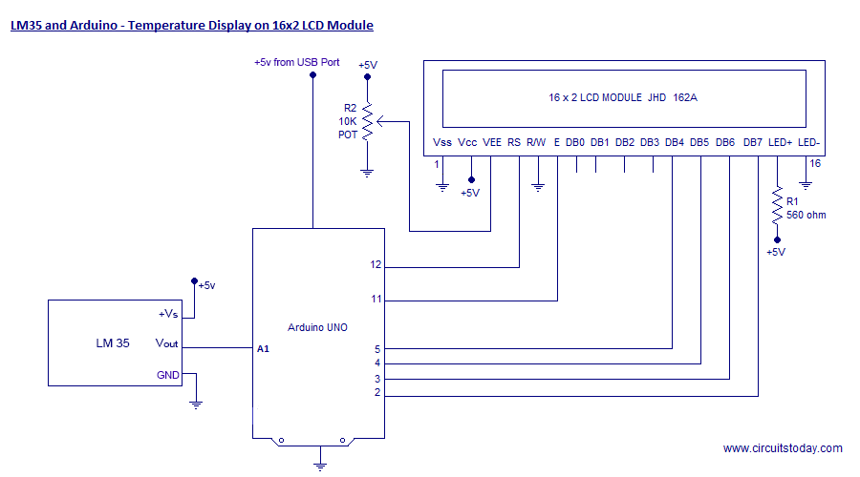

Slide 29
#include <EEPROM.h>
#include <SoftwareSerial.h>
SoftwareSerial BT_Serial(2, 3); // RX, TX
#define Relay1 10 // Load1 Pin Out
#define Relay2 11// Load2 Pin Out
#define Relay3 12// Load3 Pin Out
#define Relay4 13// Load4 Pin Out
char bt_data; // variable to receive data from the serial port
int load1, load2, load3, load4, power;

Slide 30
#include<LiquidCrystal.h>
LiquidCrystal lcd(9, 8, 7, 6, 5, 4);
const int sensor=A1; // Assigning analog pin A1 to variable 'sensor'
float tempc; //variable to store temperature in degree Celsius
float tempf; //variable to store temperature in Fahreinheit
float vout; //temporary variable to hold sensor reading
const int buttonPin = A2; // the number of the pushbutton pin
const int ledPin = A3; // the number of the LED pin
// variables will change:
int buttonState = 0; // variable for reading the pushbutton status

Slide 31
void setup()
pinMode(sensor,INPUT); // Configuring pin A1 as input
pinMode(ledPin, OUTPUT);
// initialize the pushbutton pin as an input:
pinMode(buttonPin, INPUT);
Serial.begin(9600);
lcd.begin(16,2);
delay(500);

Slide 32
BT_Serial.begin(9600);
pinMode(Relay1, OUTPUT); digitalWrite(Relay1, 1);
pinMode(Relay2, OUTPUT); digitalWrite(Relay2, 1);
pinMode(Relay3, OUTPUT); digitalWrite(Relay3, 1);
pinMode(Relay4, OUTPUT); digitalWrite(Relay4, 1);
load1 = EEPROM.read(1);
load2 = EEPROM.read(2);
load3 = EEPROM.read(3);
load4 = EEPROM.read(4);
power = EEPROM.read(5);
delay(500);

Slide 33
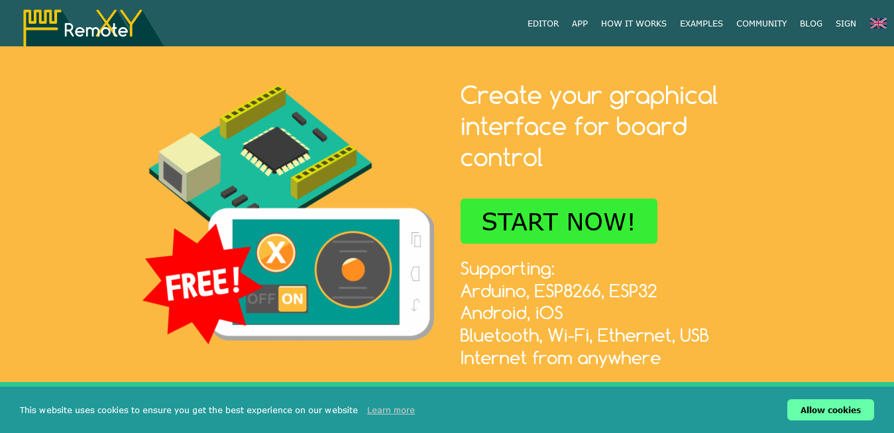
Mobile App Remotexy

Slide 34
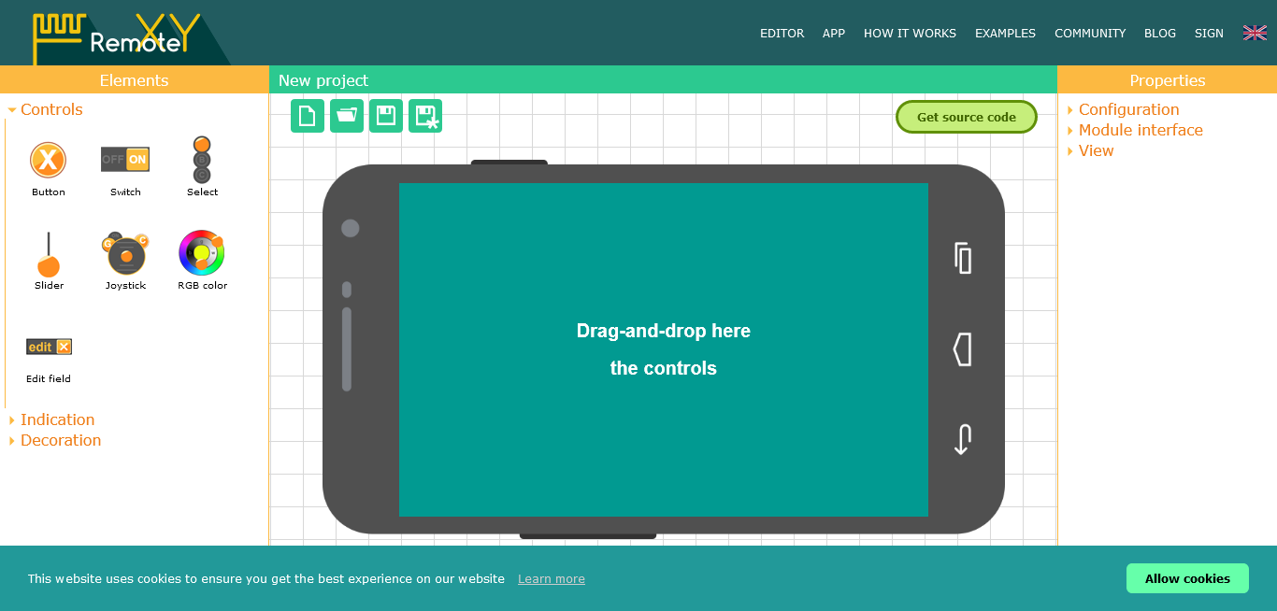
Designer

Slide 35
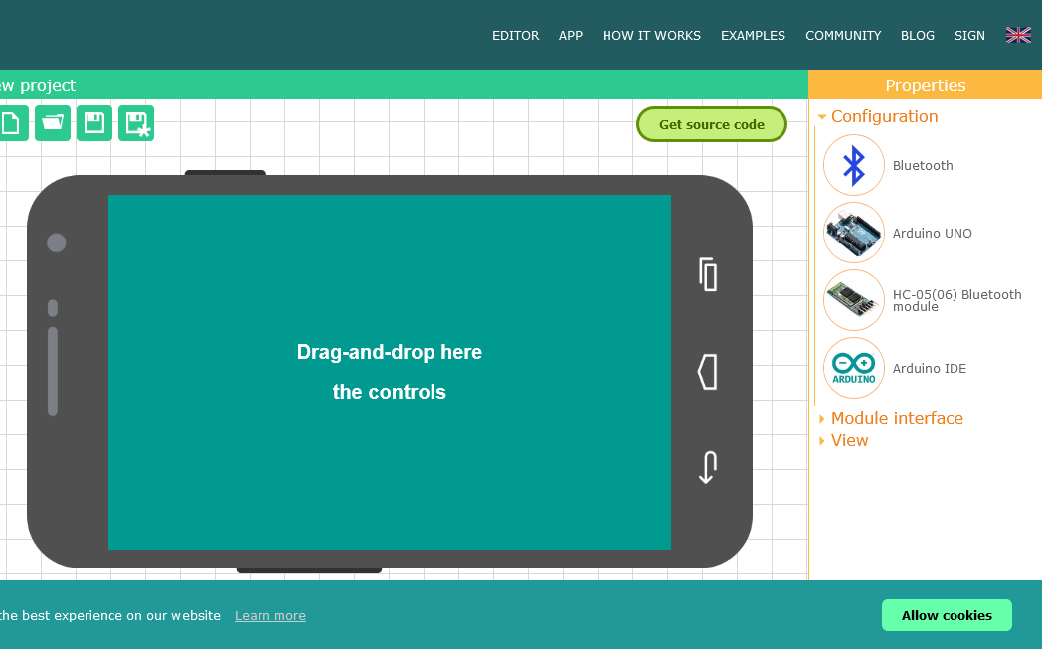
configuration

Slide 36

App Invertor

Slide 37
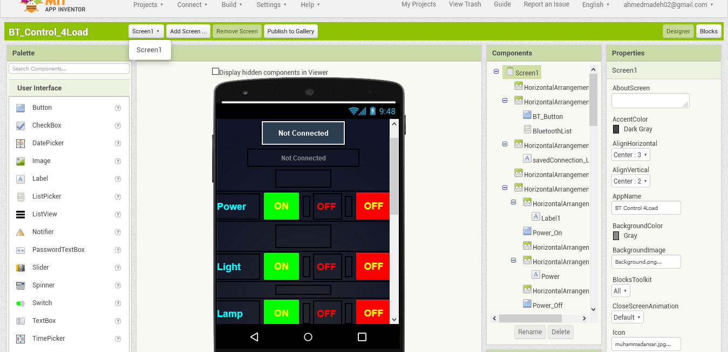
Designer

Slide 38
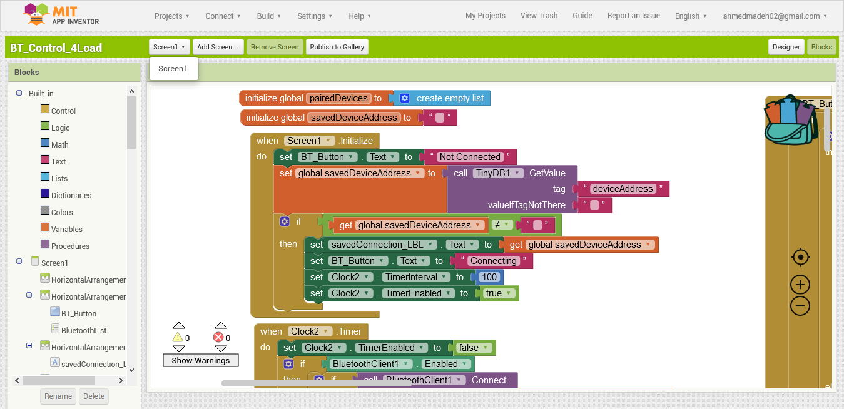
Blocks

Slide 39
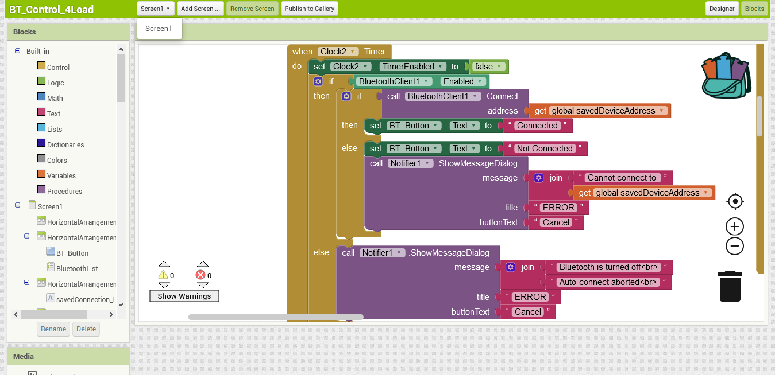
Blocks

Slide 40
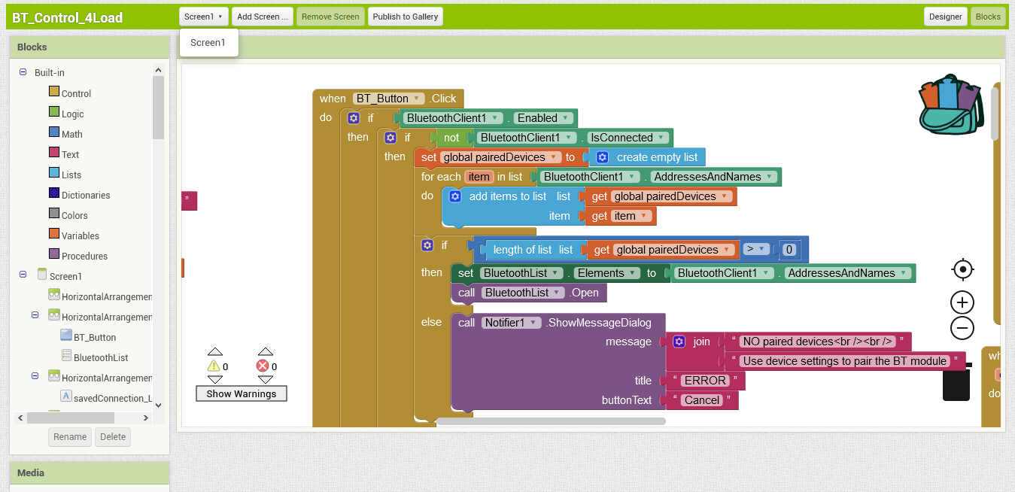
Blocks

Slide 41
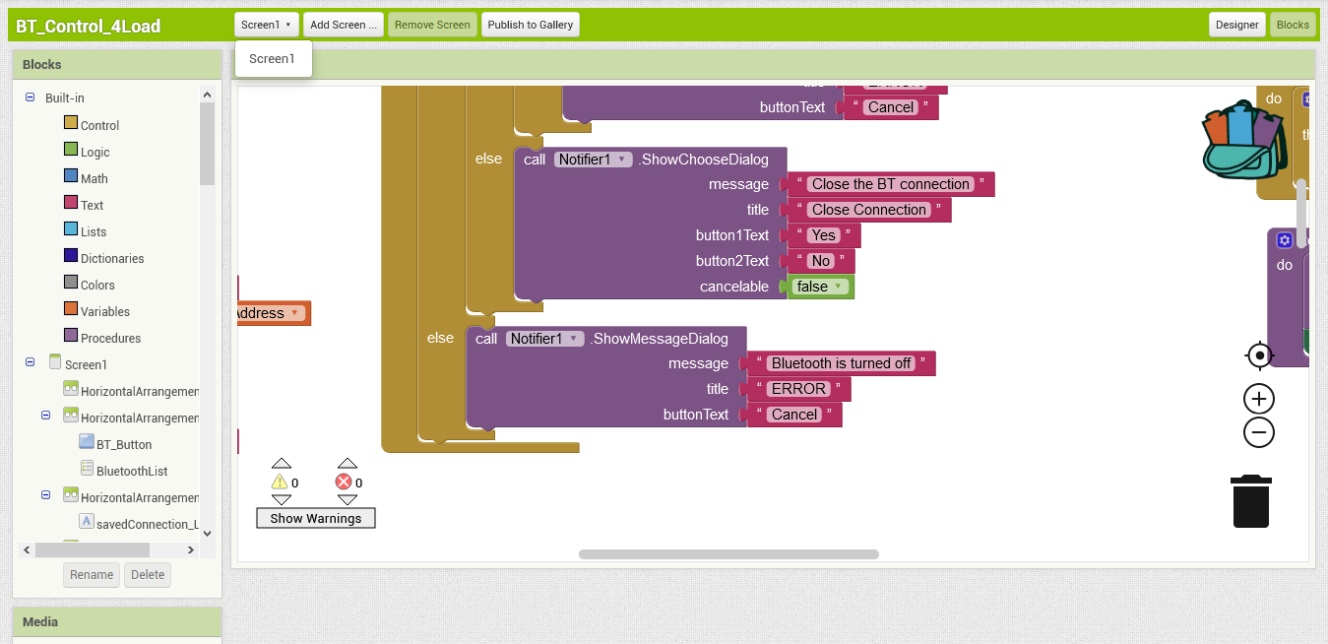
Blocks

Slide 42
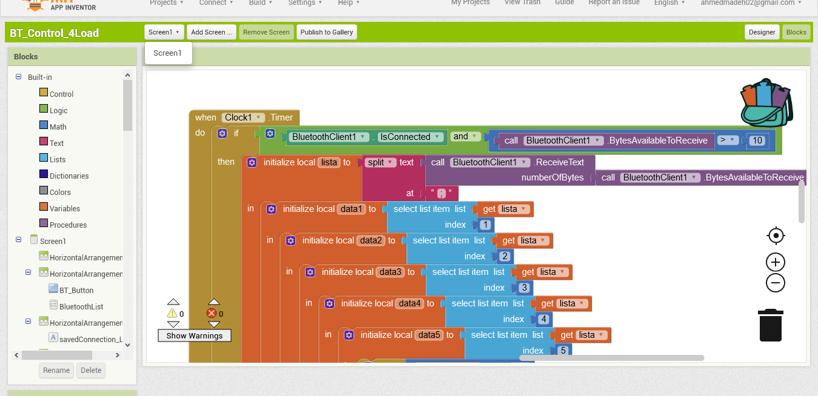
Blocks

Slide 43
what is firebase
Firebase is a platform developed by Google for creating mobile and web applications. It was originally an independent company founded in 2011 In 2014, Google acquired the platform and it is now their flagship offering for app development.
The Firebase platform has 18 products split into three groups: Develop, Quality, and Grow.

Slide 44
Uses of firebase database
The Firebase Realtime Database lets you build rich, collaborative applications by allowing secure access to the database directly from client-side code. Data is persisted locally, and even while offline, realtime events continue to fire, giving the end user a responsive experience

Slide 45
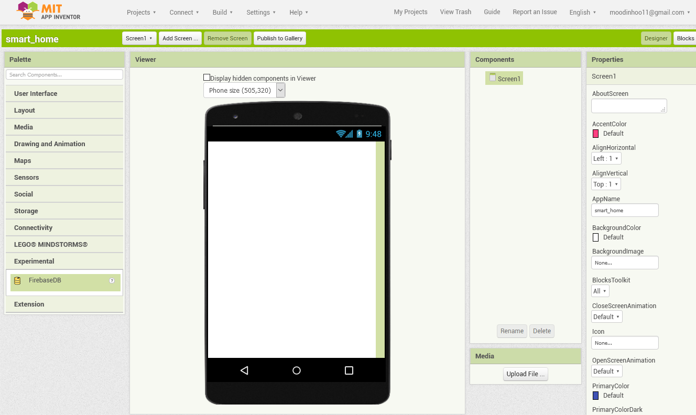
Firebase in app inventor

Slide 46
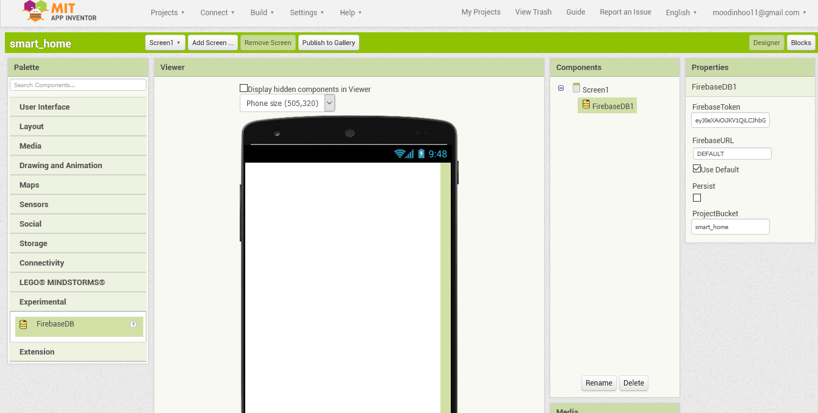
firebase

Slide 47
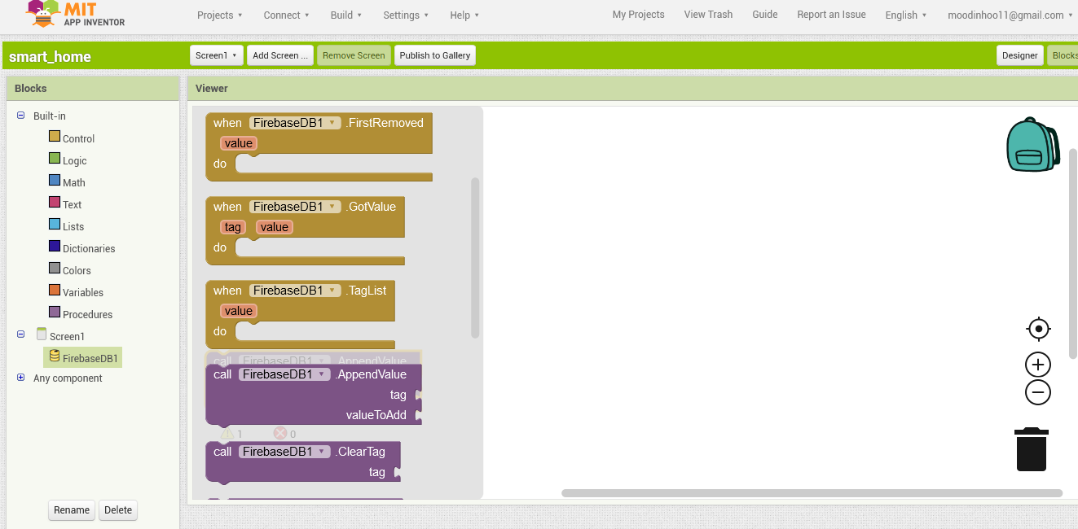
Appendvalue: add new value beside old values

Slide 48
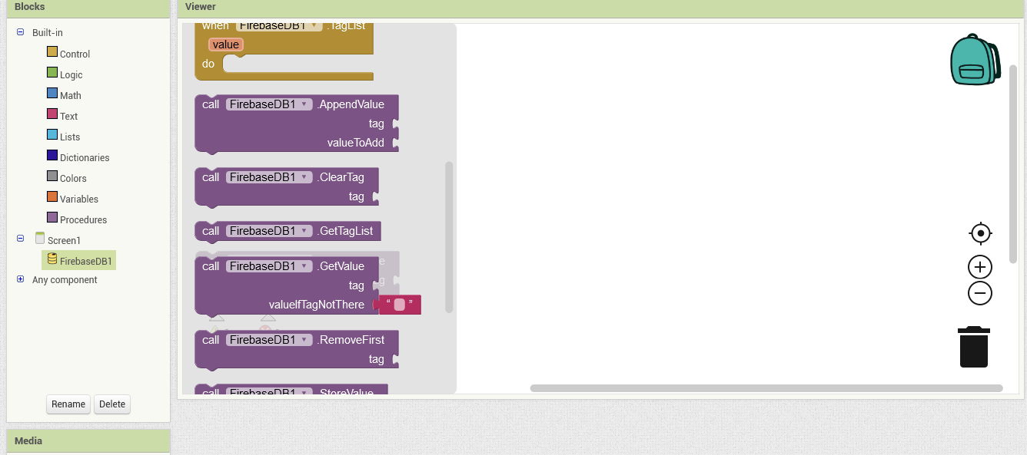
Cleartag : could clear any tag getvalue tag: could get any old tag

Slide 49


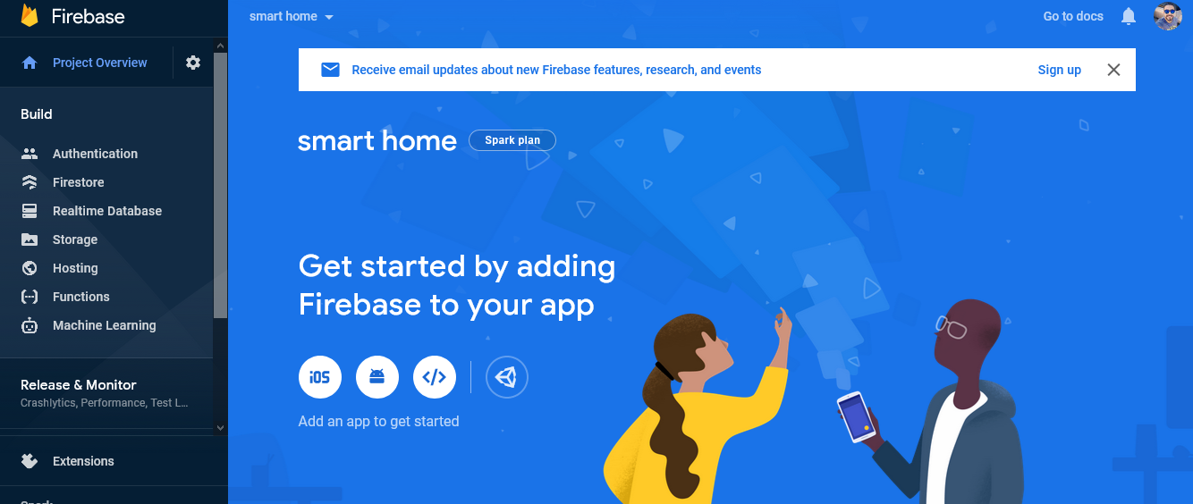




Slide 50
The security For the home BY: Amr Essam

Slide 51
Security for the Home
Simple easy to use
Effective
Secured (separated from the home system)
Automated
Serve variant situations at all the conditions
Modern
Upgradable

Slide 52
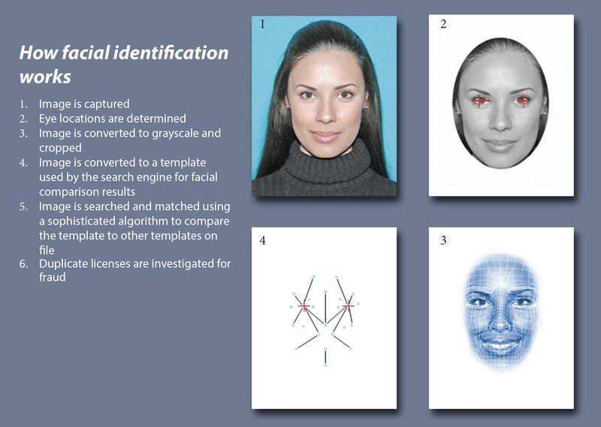
Face Recognition
Face recognition is a method of identifying or verifying the identity of an individual using their face. Face recognition systems can be used to identify people in photos, video, or in real-time.

Slide 53
Face detection and face recognition
Face Detection:
computer technology that is able to identify the presence of people’s faces within digital images. In order to work, face detection applications use machine learning and formulas known as algorithms to detecting human faces within larger images. These larger images might contain numerous objects that aren’t faces such as landscapes, buildings and other parts of humans (e.g. legs, shoulders and arms).
Face recognition:
describes a biometric technology that goes way beyond recognizing when a human face is present. It actually attempts to establish whose face it is. The process works using a computer application that captures a digital image of an individual’s face (sometimes taken from a video frame) and compares it to images in a database of stored records. While facial recognition isn’t 100% accurate, it can very accurately determine when there is a strong chance that an person’s face matches someone in the database.

Slide 54
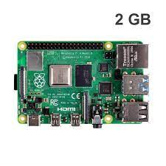
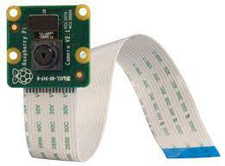
Hardware Components:
Raspberry Pi 4
Camera Module v2

Slide 55

Software:
Raspbian Buster
VNC Viewer
Python
Python libraries
Open CV
NumPy
Face Detection Using Harscade .Xml File

Slide 56
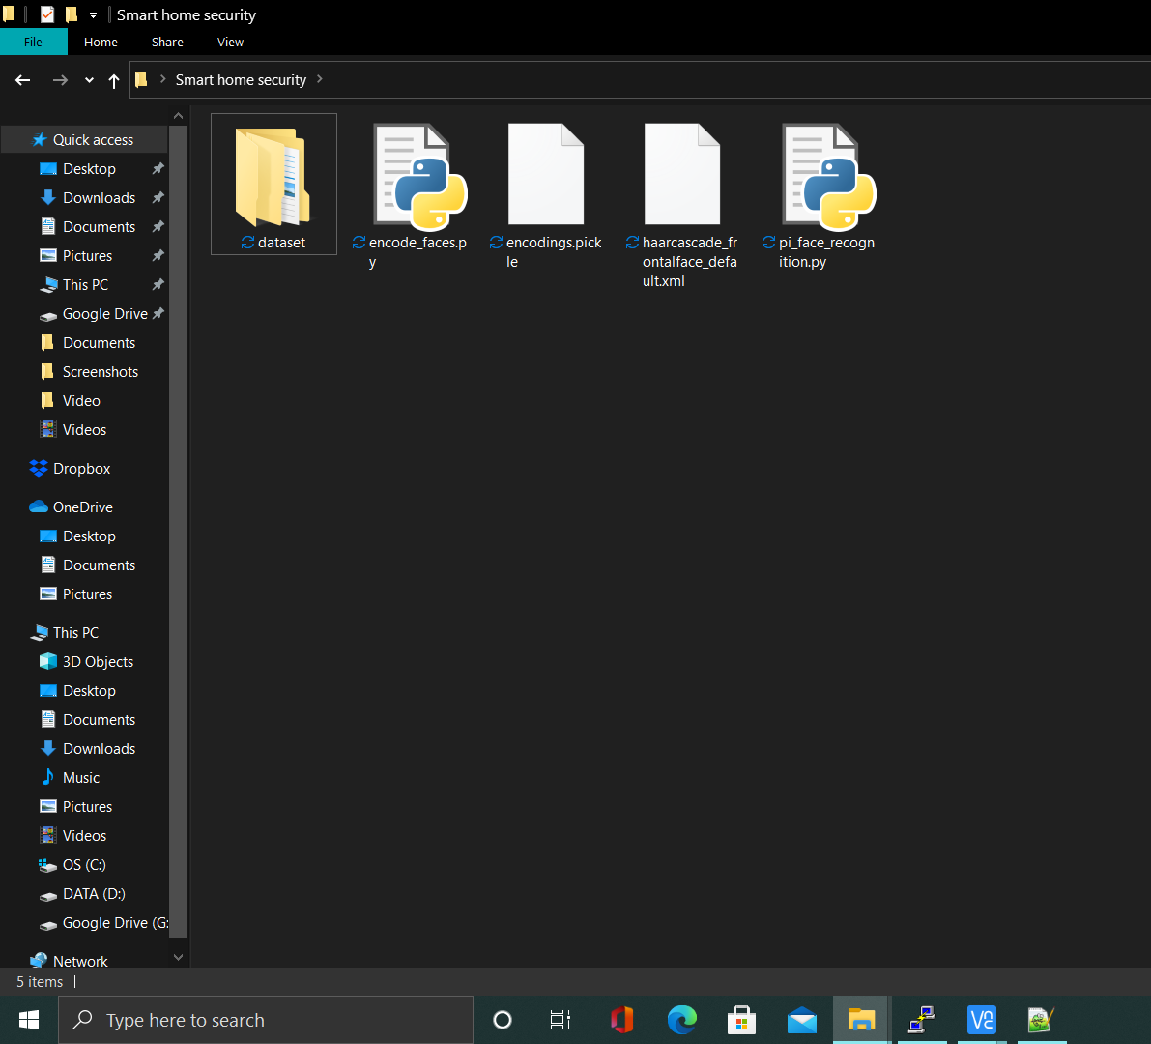
Code Files
Dataset
encode_faces
Encodings
haarcascade_frontalface_default
pi_face_recognition

Slide 57
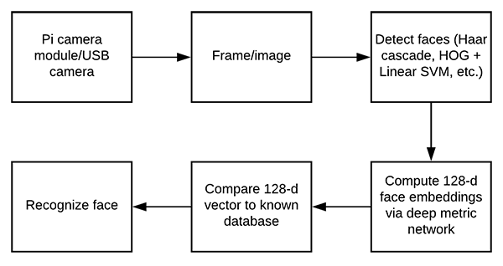
Flow chart

Slide 58
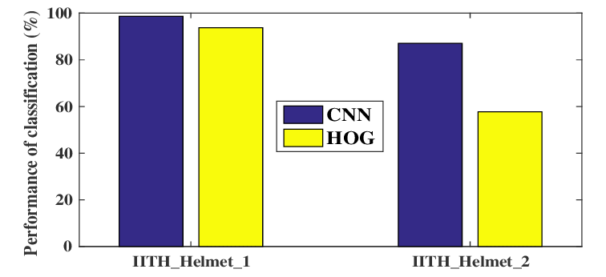
HOG and CNN

Slide 59
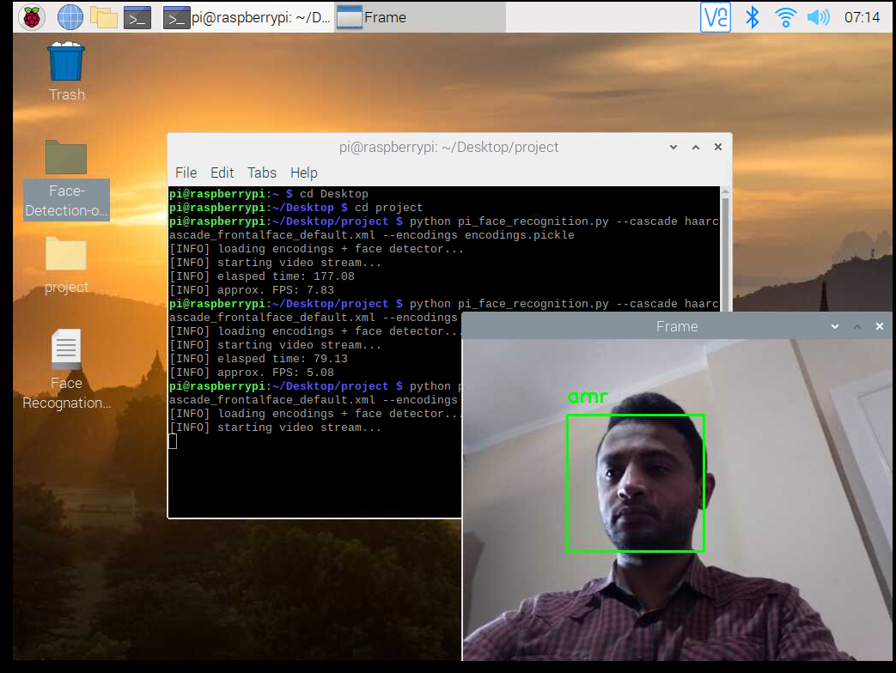
The Results

Slide 60
Face Recognition Usage
PREVENT RETAIL CRIME
UNLOCK PHONES
SMARTER ADVERTISING
FIND MISSING PERSONS
HELP THE BLIND
AID FORENSIC INVESTIGATIONS
IDENTIFY PEOPLE ON SOCIAL MEDIA PLATFORMS
RECOGNIZE VIPS AT SPORTING EVENTS
TRACK SCHOOL ATTENDANCE
VALIDATE IDENTITY AT ATMS
CONTROL ACCESS TO SENSITIVE AREAS

